Slide 1
E-BAND HEALTH MONITORING SYSTEM (Internet-of-Things (IOT), Cloud Based Analytics and WebApp) under the guidance of Prof. Shraddha .S. Suratkar
Group Members:
Prince Gawde (151070970)
Merlin Simoes (151071971)
Kajal Dalai (151071972)
Snehal Ahire (151071974)

Slide 2
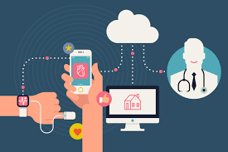

Slide 3
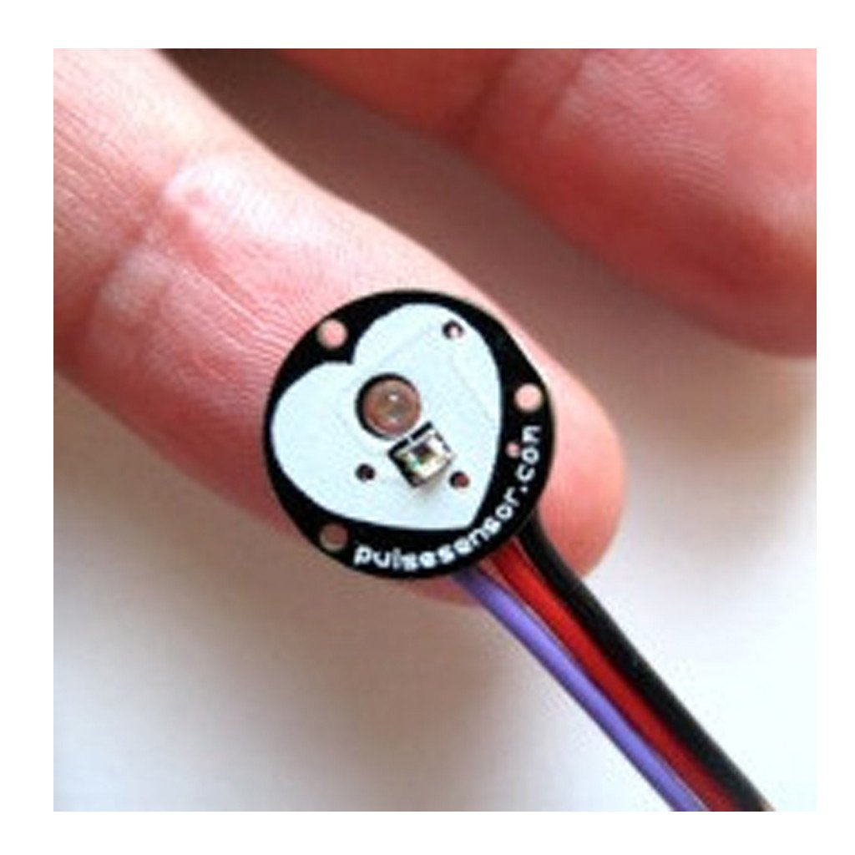
PULSE SENSOR

Slide 4
PROBLEM STATEMENT
A person can be diseased if the heart rate increases or decreases linearly over a period of time. This cannot be regularly monitored by people because of their busy schedules.
In this case, the E-BAND Health Monitoring System monitors the patient’s health status and it generates daily reports based on patient’s health.
On the off chance that when the patient gets lethal the beat sensor will detect the patient's heartbeat rate instantly and it will alarm his relatives by sending the patient's location through GPS co-ordinates by sending alert messages on the cell phone.
Patient can view daily health status on the WebApp.

Slide 5
INTRODUCTION
E-Glove Health Monitoring System an electronic wearable device basically monitors the health of the patient by detecting its pulse rate with the help of the hardware device and pulse sensor.
In case when the patient gets fatal the pulse sensor will sense the patient’s pulse rate immediately and it will alert his family members by sending the patient’s location through GPS co-ordinates by sending alert messages through GSM module.
It also has an alerting system (piezo-electric buzzer) which would alert the public about the patient's condition.

Slide 6
OBJECTIVES OF PROJECT
Patient Safety
Effectiveness
Timeliness
Patient Centered
Efficiency
Equity

Slide 7
NEED
The provision of high-quality, affordable, health care services is an increasingly difficult challenge.
Due to the complexities of health care services and systems, investigating and interpreting the use, costs, quality, accessibility, delivery, organization, financing, and outcomes of health care services is key to informing government officials, insurers, providers, consumers, and others making decisions about health-related issues.
Health services researchers examine the access to care, health care costs and processes, and the outcomes of health services for individuals and populations.

Slide 8
LITERATURE SURVEY
Sr.No | Name | Citation
1. | Heart rate monitoring system using finger tip through arduino and processing software Published in: International Journal of Science, Engineering and Technology Research (IJSETR), Volume 5, Issue 1, January 2016 Link: http://ijsetr.org/wp-content/uploads/2016/01/IJSETR-VOL-5-ISSUE-1-84-89.pdf | This paper describes a technique of measuring the heart rate through a fingertip and Arduino. Heart rate is a very vital health parameter that is directly related to the soundness of the human cardiovascular system. It can be measured either by the ECG waveform or by sensing the pulse - the rhythmic expansion and contraction of an artery as blood is forced through it by the regular contractions of the heart.
2. | Photonic sensor design evaluation for measuring the photoplethysmogram Published in: Instrumentation and Measurement Technology Conference Proceedings (I2MTC), 2016 IEEE International Link: http://ieeexplore.ieee.org/document/7520561/ | Recently noninvasive cuffless and continuous measurement techniques of photoplethysmogram (PPG) signals get lots of attention in medical diagnosis for 24/7 monitoring. Moreover, the strive towards low cost, portability, simple construction and simple analysis techniques paves the way for mobile health care. Several research papers have been published on PPG sensors to extract the PPG signal which consider only one specific source, either a LED or a Laser diode.

Slide 9
Continue…
Sr.No | Name | Citation
3. | Evaluation of wearable consumer heart rate monitors based on photopletysmography Published in: Engineering in Medicine and Biology Society (EMBC), 2014 36th Annual International Conference of the IEEE Link: http://ieeexplore.ieee.org/document/6944419/ | Wearable monitoring of heart rate (HR) during physical activity and exercising allows real time control of exercise intensity and training effect. Recently, technologies based on pulse plethysmography (PPG) have become available for personal health management for consumers. However, the accuracy of these monitors is poorly known which limits their application. The estimated results indicate that performance of devices depends on various parameters, including specified activity, sensor type and device placement.
4. | ESP8266 based implementation of wireless sensor network with Linux based web-server Published in: Colossal Data Analysis and Networking (CDAN), Symposium on Link: http://ieeexplore.ieee.org/abstract/document/7570919/ | An integrated system platform which can provide Linux web server, database, and PHP run-time environment was built by using ARM Linux development board with Apache+PHP+SQLite3. Various Internet accesses were offered by using Wi-Fi wireless networks communication technology.

Slide 10
Continue…
Sr.No | Name | Citation
5. | A Review of Measurement and Analysis of Heart Rate Variability Published in: Computer and Automation Engineering, 2009. ICCAE '09. International Conference on Link: http://ieeexplore.ieee.org/document/4804526/ | Pulse sensor is one of the most important physiological parameter that gives correct assessment of heart function. QRS complex is a prominent waveform in a pulse sensor that provides the basis for analyzing heart rate variability (HRV). HRV refers to the beat-to-beat alterations in heart rate. The significance and meaning of these different measures of HRV are a potential area of research.
6. | Working principle of arduino and using it as a tool for study and research Published on:Department of Electronics and Communication Engineering, Gujarat Technological University, Ahmedabad, India Link: http://airccse.com/ijcacs/papers/1216ijcacs03.pdf | Arduino is an open source microcontroller which can be easily programmed, erased and reprogrammed at any instant of time. It is also capable of receiving and sending information over the internet with the help of various Arduino shields, which are discussed in this paper. Arduino uses a hardware known as the Arduino development board and software for developing the code known as the Arduino IDE (Integrated Development Environment).

Slide 11
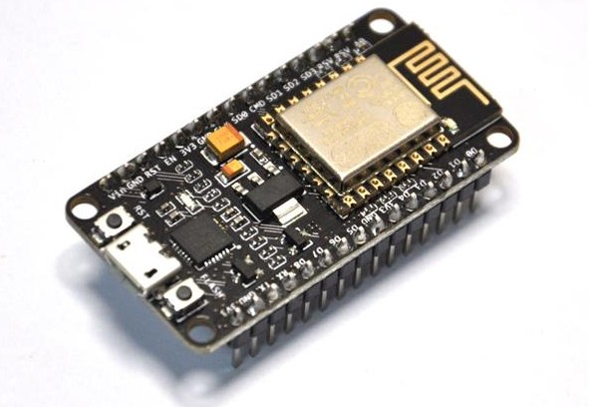
HARDWARE RESOURCE
1. ESP8266 NodeMCU WiFi Devkit
The ESP8266 itself is a self-contained WiFi networking solution offering as a bridge from existing micro controller to WiFi and is also capable of running self-contained applications

Slide 12
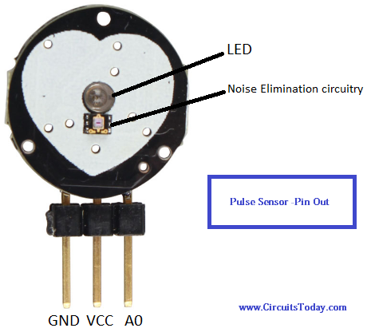
PULSE SENSOR
The Pulse Sensor is the low-cost optical heart rate sensor (PPG) for Arduino and other microcontrollers. The Pulse Sensor is a plug-and-play heart-rate sensor for Arduino.

Slide 13
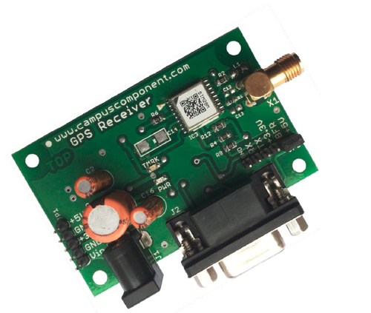
GPS RECEIVER MODULE
A GPS navigation device is a device that is capable of receiving information from GPS satellites and then to calculate the device's geographical position.

Slide 14
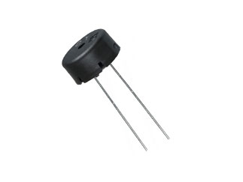
PIEZOELECTRIC BUZZER
A buzzer is a mechanical, electromechanical, magnetic, electromagnetic, electro-acoustic or piezoelectric audio signalling device. A piezo electric buzzer can be driven by an oscillating electronic circuit or other audio signal source.

Slide 15
SOFTWARE RESOURCE
ThingSpeak API
ThingSpeak provides apps that allow us for an easier integration with the web services, social networks and other APIs. Below are some of the apps provided by ThingSpeak:
ThingTweet –
This allows you to post messages to twitter via ThingSpeak. In essence, this is a TwitterProxy which re-directs your posts to twitter.
ThingHTTP –
This allows you to connect to web services and supports GET, PUT, POST and DELETE methods of HTTP.

Slide 16
TweetControl
Using this, you can monitor your Twitter feeds for a specific key word and then process the request. Once the specific keyword is found in the twitter feed, you can then use ThingHTTP to connect to a different web service or execute a specific action.
React
Send a tweet or trigger a ThingHTTP request when the Channel meets a certain condition.
TalkBack
Use this app to queue up commands and then allow a device to act upon these queued commands.
Timecontrol
Using this app, we can do a ThingTweet, ThingHTTP or a TalkBack at a specified time in the future. We can also use this to allow these actions to happen at a specified time throughout the week.

Slide 17
IFTTT
The information about the patient is sent to the ActOn module using IFTTT Maker applet.
The steps involved are:
Step 1: Connect through your IF app (aka IFTTT) to the new Maker channel, you will receive an unique key "YOURKEY" followed by a URL to fire the "test" event
Step 2: Paste the maker key inside our Thinghttp app of ThingSpeak with body as triggered value. SMS is received at the destination .

Slide 18
WEB APP
As the part of the project we have implemented a web application model in order to track the heart-beat of a particular patient and monitor it correctly and give the accurate patient’s health report daily. Web app is developed using following software's and programming language.
1. Xampp
2. MySql
3. Ruby on Rails

Slide 19
ARDUINO IDE
The Arduino Integrated Development Environment - or Arduino Software (IDE) - contains a text editor for writing code, a message area, a text console, a toolbar with buttons for common functions and a series of menus. It connects to the Arduino and Genuino hardware to upload programs and communicate with them.

Slide 20
IFTTT Interface
ClickSend
BLOCK DIAGRAM
Node MCU ESP8266
Pulse Sensor
WiFi Module (ESP8266)
ThingSpeak
Cloud Platform
Cell
Phone
1. Alert messages
through ClickSend
2. GPS Co-ordinates
GPS Module
SIM28ML
1. Daily report of patient’s health status
Web
App
Buzzer

Slide 21
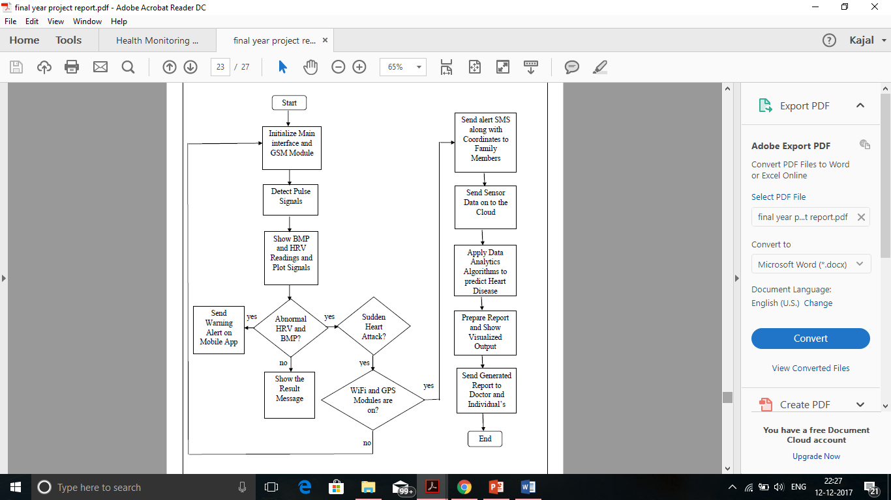
PROPOSED ALGORITHM
Flow Chart

Slide 22
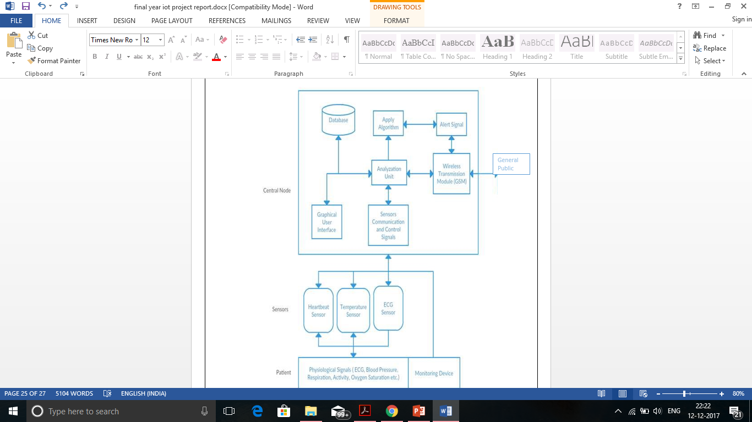
SYSTEM ARCHITECTURE

Slide 23
MATHEMATICAL MODEL
To predict a heart rate for a specific point in time we use a mathematics to model heart rates and predict what it might be in 5, 15, 30 and 60 seconds. The model used is known as linear regression and in the field of statistics is expressed as y=Χβ+ε where (1)
Χ is the regressors, or in plain english it will be 5, 15, 30 and 60 seconds time points where we want to predict your heart rate.
β is the regression coefficients. Statistical estimation and inference determines these values and are interpreted as the partial derivatives of the depend variable with respect to the independent variables. In the case of this app a sample of previous heart rate measures. There are more than one methodology to calculate these estimates, the one we use a technique as ordinary least squares (OLS) that minimise the sum of squared residuals to estimate the parameter β such that:
β=(Χ^{T}X)⁻¹Χ^{T}y holds (2)
ε is the error term or sometimes known as noise. This variables captures things that might influence the model are not intended to take into account. Like all models there are assumptions and without going into the nitty gritty of the maths, they are:

Slide 24
CONTINUE…
We assume weak exogeneity. It simply means our heart rate is not random; we don’t expect a heart rate of 140 bpm and then suddenly 60 bpm within 1 second.
Linearity: We assume that the average of heart rate measurement is a linear combination of the regressions coefficients and time.
Homoscedasticity: It means that within out time frame of the model (i.e. 60 seconds), all the response variables has the same variance (i.e. volatility) in regard of the predators variables (in the App time is the predictor).
Independence of errors: The model assumes that the errors in the response variables are uncorrelated. (i.e. unrelated). For example, we say that the fact that you pick up a water bottle cannot be predicted and is random.
Lack of multicollinearity: Since the prediction time is under 60 seconds this does not apply, unless your training repetition is under 60 seconds.

Slide 25
MATHEMATICAL FORMULAS
BPM = 60∑ (𝑇[𝑖]−𝑇[𝑖 −1])/(𝑚−1) 𝑚 𝑖=1
HVR = random(10,200) + (heartbeats) *60

Slide 26
IMPLEMENTATION
DATA ANALYTICS
ThingSpeak is a platform providing various services exclusively targeted for building IoT applications.
The core element of ThingSpeak is a ‘ThingSpeak Channel’. A channel stores the data that we send to ThingSpeak and comprises of the below elements:
8 fields for storing data of any type - These can be used to store the data from a sensor or from an embedded device.
3 location fields - Can be used to store the latitude, longitude and the elevation. These are very useful for tracking a moving device.
1 status field - A short message to describe the data stored in the channel.

Slide 27
INTERFACE DESCRIPTION
The pulse sensor senses the person’s pulse which sends out the data on microcontroller (Node MCU)
Node MCU is a WiFi integrated model which sends out the data on cloud platform i.e. ThingSpeak
ThingSpeak performs the data analysis and produces easily interpreted graphical statistical reports in the form of scatter diagram.
When the patient gets fatal and the threshold value i.e. 80-120 increases the system triggers the heartbeat event on the cloud platform and sends alert messages on the cell phone.
The alert messages on the cell phone are sent through ClickSend.
ClickSend is a service provided by the IFTTT interface.
Patient’s health status report generated can be viewed through E-BAND Health Monitoring System WebApp.

Slide 28
IFTTT INTERFACE
The information about the patient is sent to the ActOn module using IFTTT Maker applet.
The steps involved are:
Step 1: Connect through your IF app (aka IFTTT) to the new Maker channel, you will receive an unique key "YOURKEY" followed by a URL to fire the "test" event
Step 2: Paste the maker key inside our Thinghttp app of ThingSpeak with body as triggered value. SMS is received at the destination.

Slide 29
ADVANTAGES
Quick and reliable.
Measurements of HRV are noninvasive and highly reproducible.
Assesses cardiovascular health, management of disease progression, and the effects of medication, therapies, lifestyle changes and dietary habits.

Slide 30
DISADVANTAGES
Excluding Heart Rate Data when human is mobile/running, from the observed Dataset using Accelerometer.
Data cannot be sent to the cloud directly. It should be done through mobile/public WiFi which is has Internet connectivity.

Slide 31
APPLICATIONS
Diabetics
- Heart rates of ∼100 bpm with occasional increments up to 130 bpm
Bradycardia
- It is a sign of a problem with the heart's electrical system, heart beats less than 60 bpm, it is slower than normal
Cerebrovascular disease
- Very fast rates of 200 bpm or more can precipitate heart failure
Hypertension
– Heart rate constantly ranging from 100-200.
Tachycardia
-Tachycardia, also called tachyarrhythmia, is a heart rate that exceeds the normal resting rate. In general, a resting heart rate over 100 beats per minute is accepted as tachycardia in adults.

Slide 32
POSSIBLE OUTCOMES
The value of health care services lies in their capacity to improve health outcomes for individuals and populations.
Health outcomes are broadly conceptualized to include clinical measures of disease progression, patient-reported health status or functional status, satisfaction with health status or quality of life, satisfaction with services, and the costs of health services.
Heart Rate Variability (HRV), Beats Per Minute (BPM) readings through pulse detection sensor.
Cloud based visualization and patient-reported health status based on HRV and BPM using Data Analytics.
Alert messages to family members when the health status is not normal.
If an individual is prone to sudden heart attack, Piezo-electric buzzer will alert the public around.

Slide 33
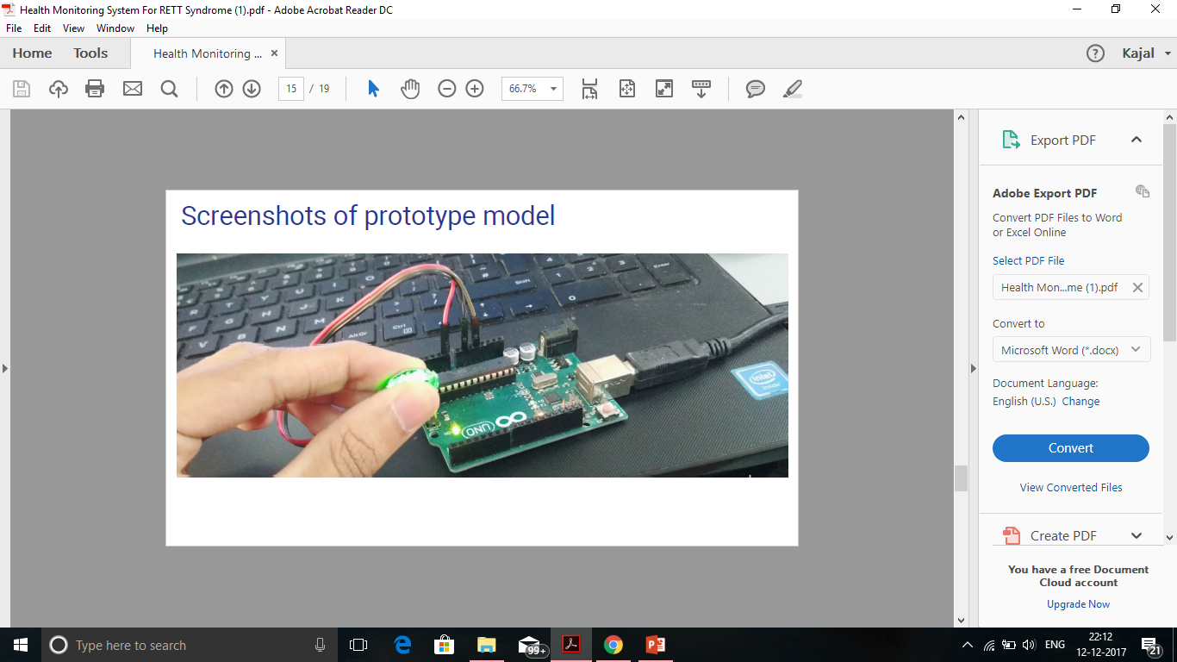
SCREENSHOT OF HARDWARE SYSTEM

Slide 34
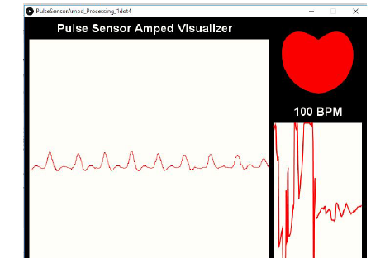
SCREENSHOTS OF PROTOTYPE MODEL

Slide 35
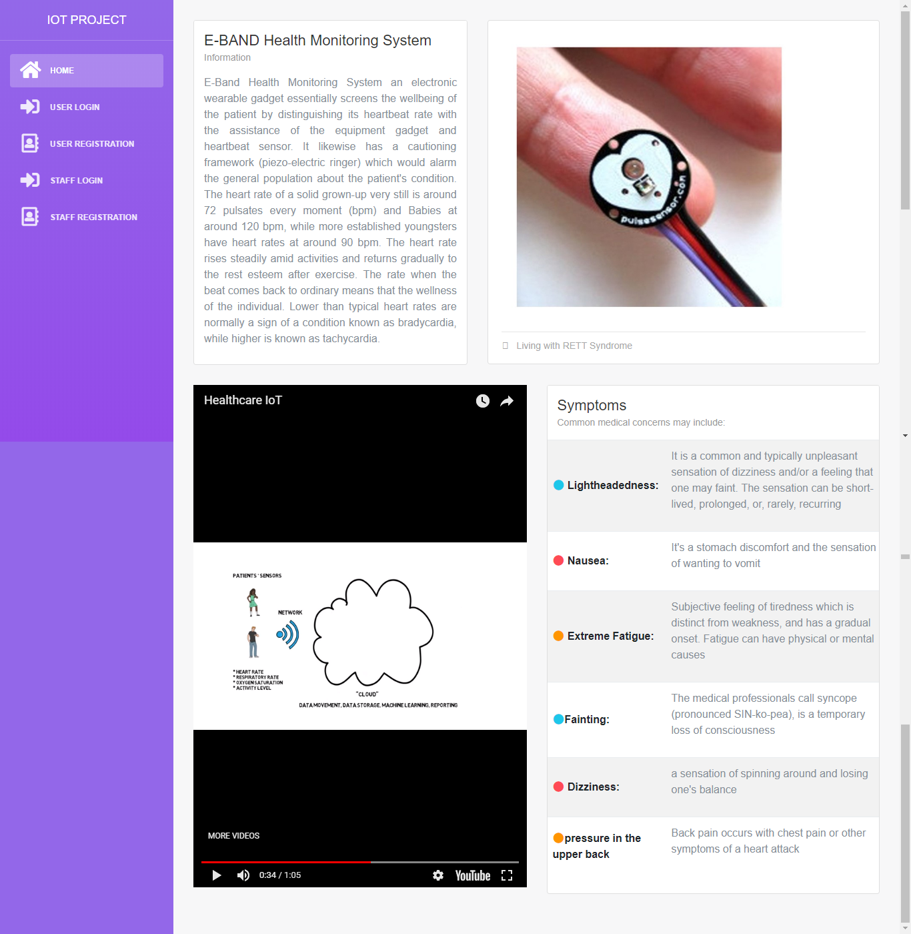
WEB APP SCREENSHOTS

Slide 36
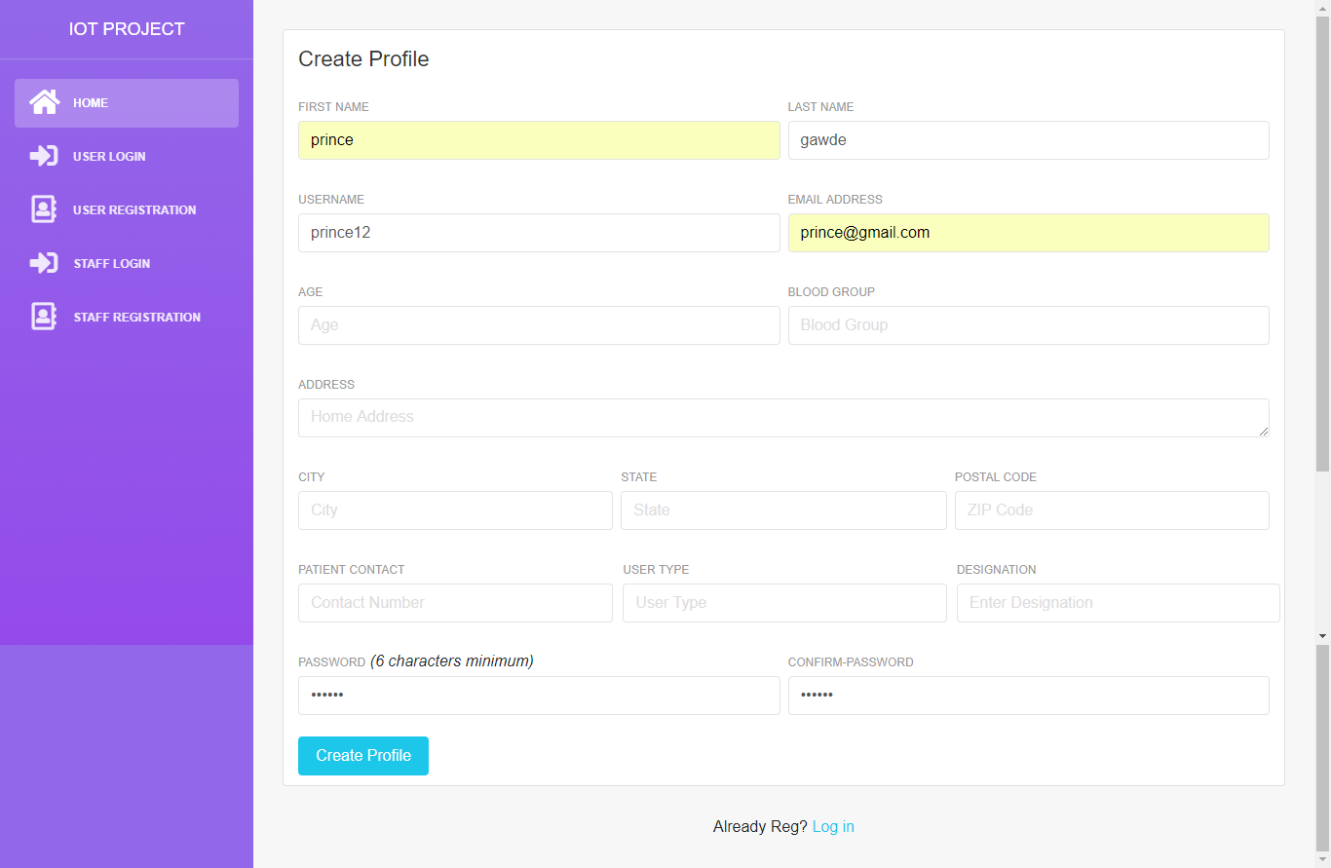

Slide 37
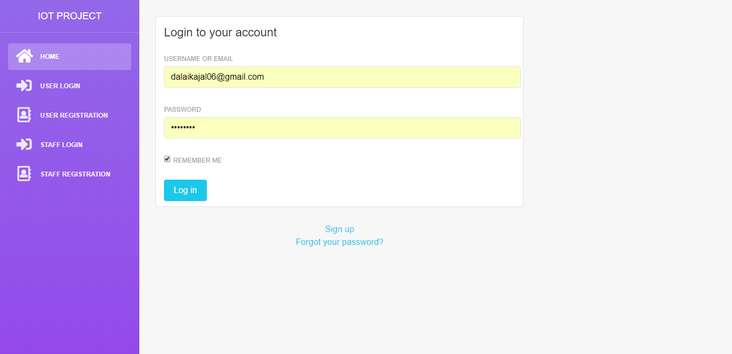

Slide 38
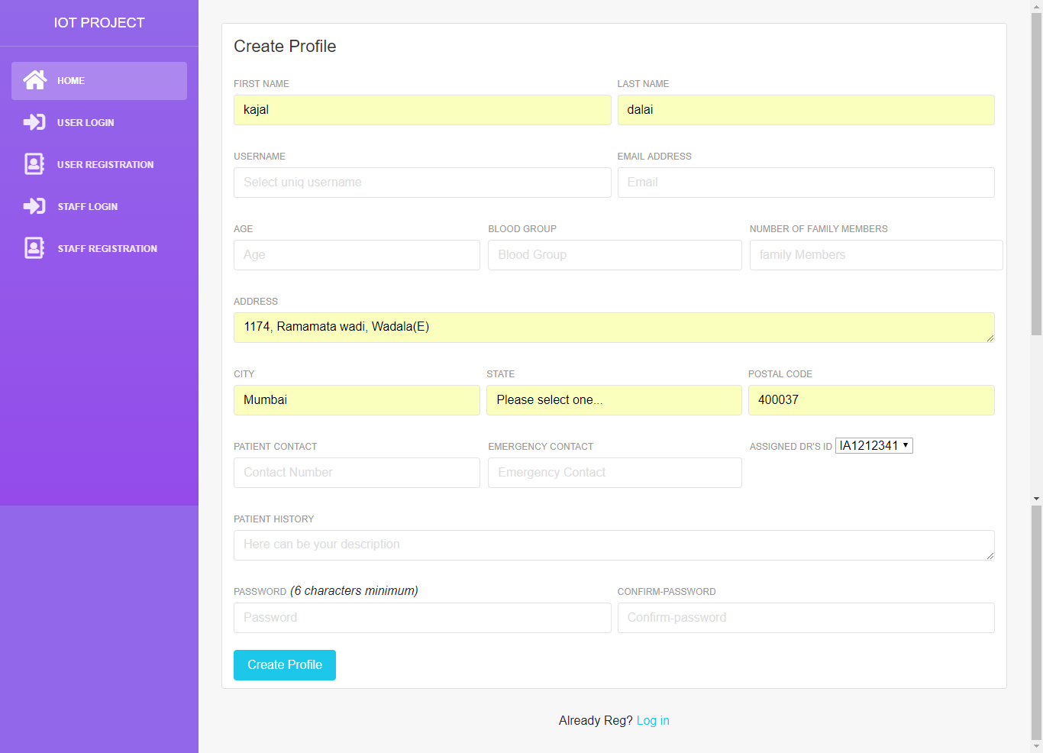

Slide 39
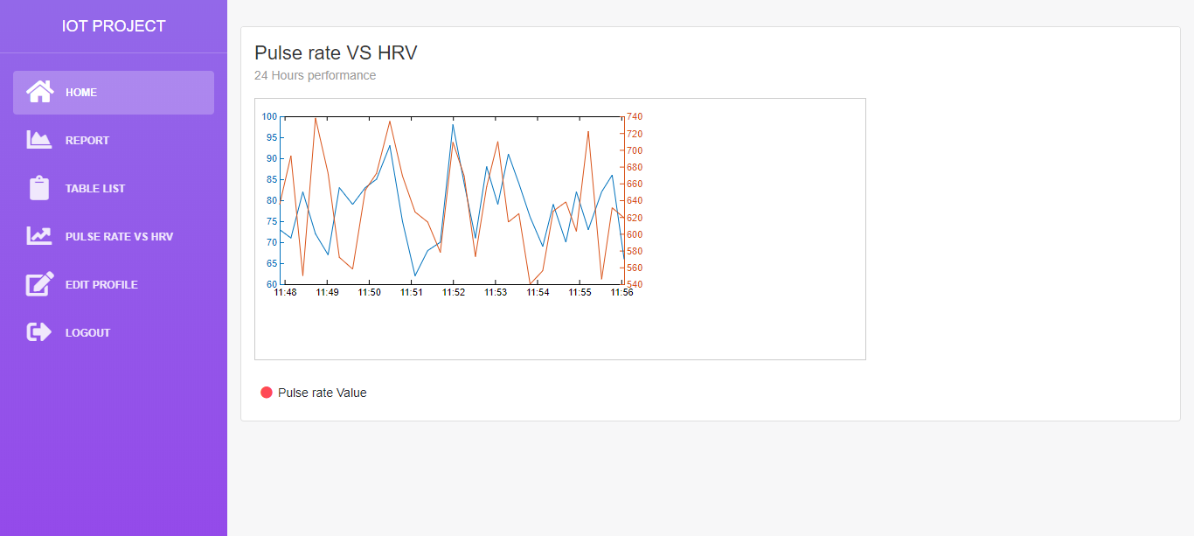

Slide 40
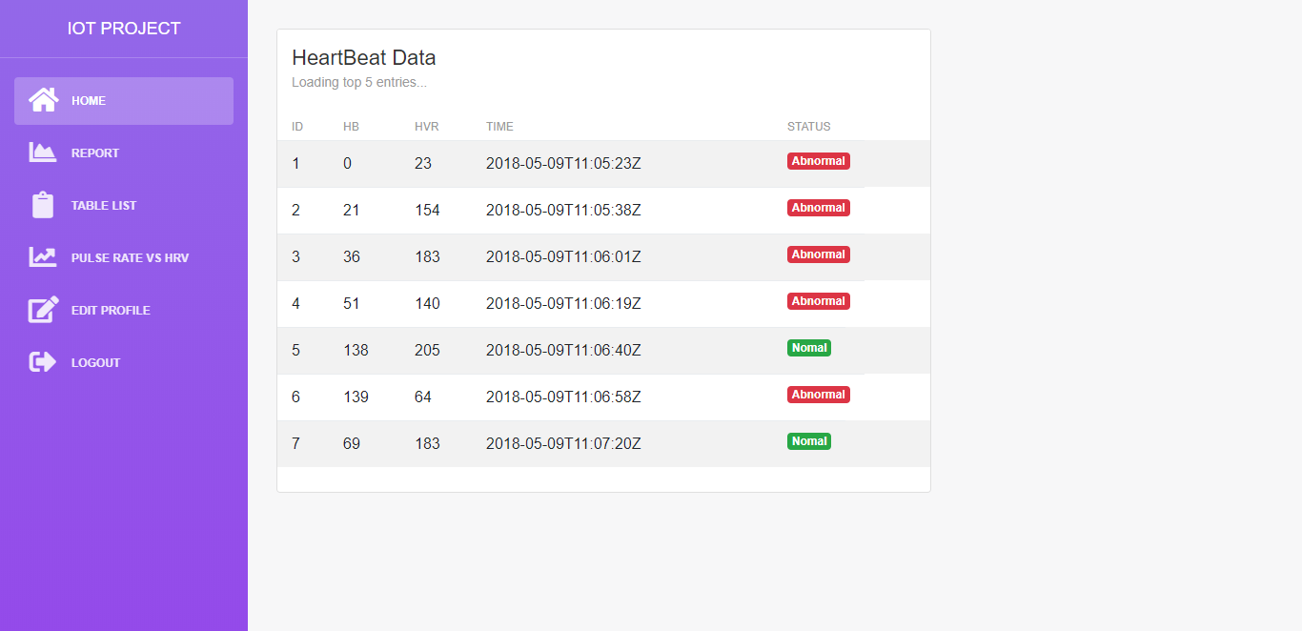

Slide 41
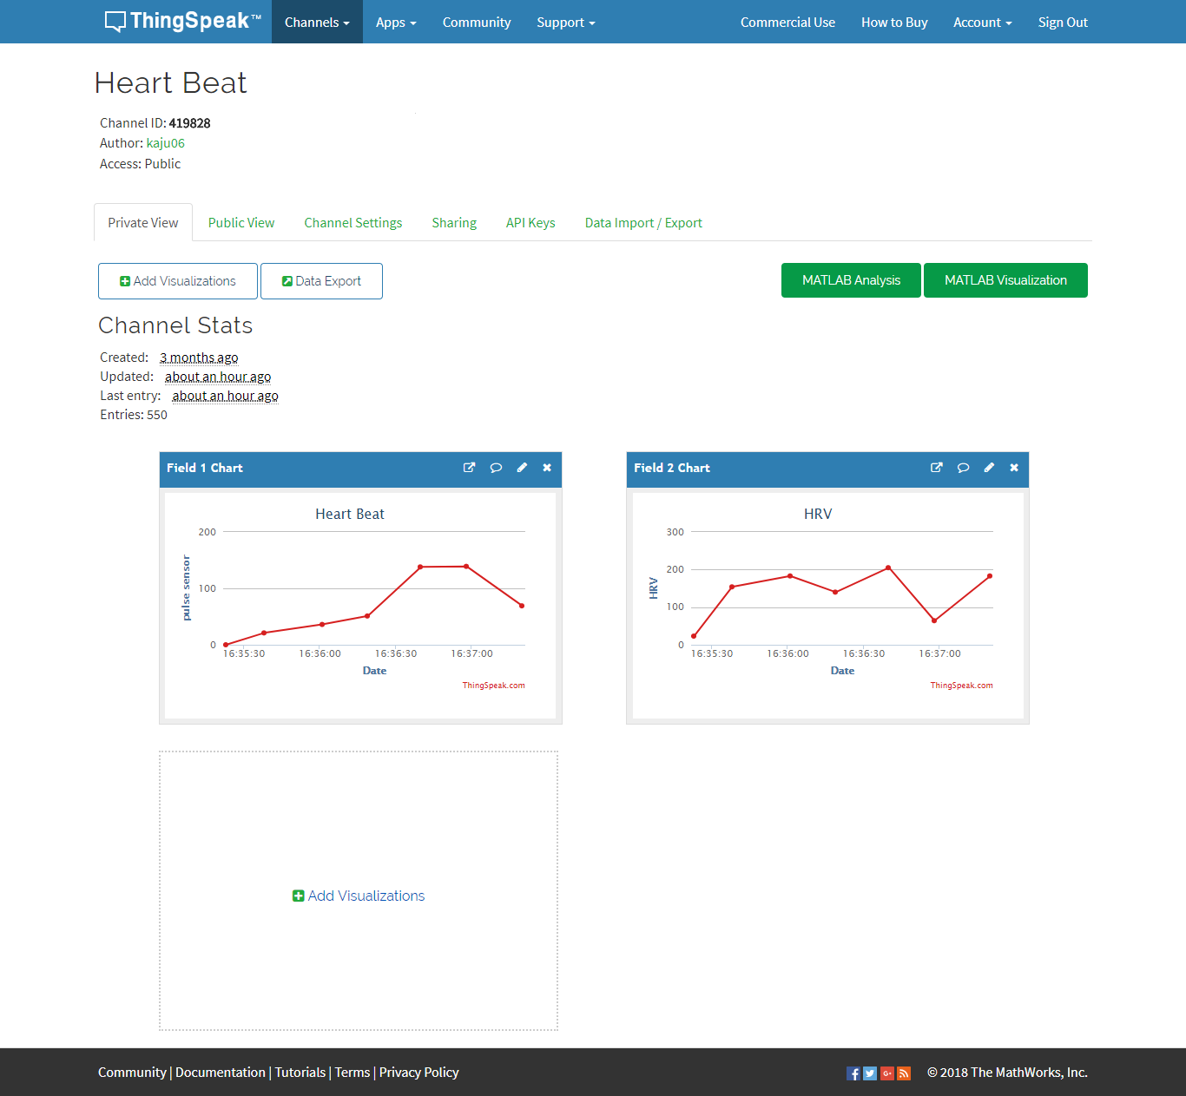
THINGSPEAK CLOUD SCREENSHOT

Slide 42
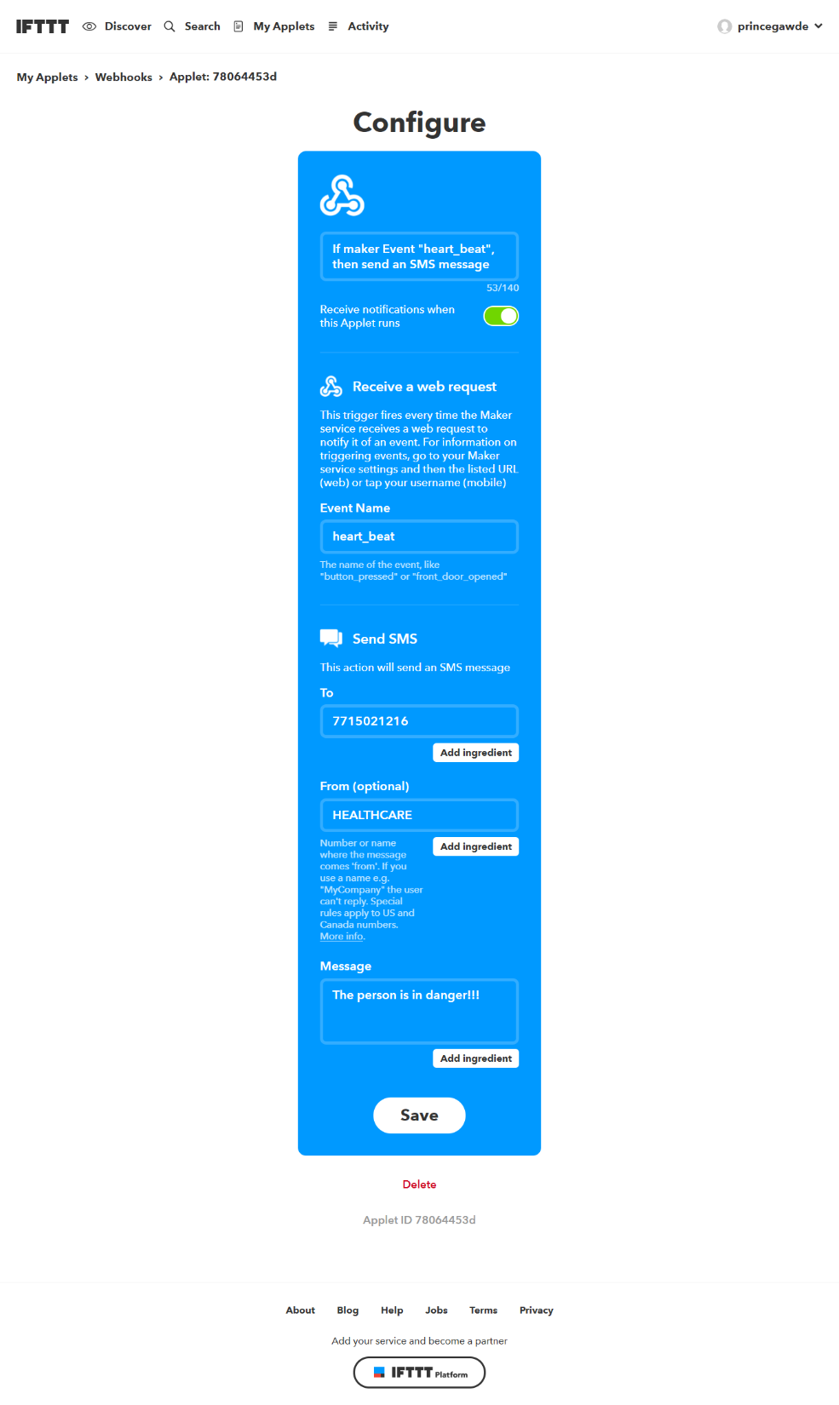
IFTTT INTERFACE SCREENSHOT

Slide 43
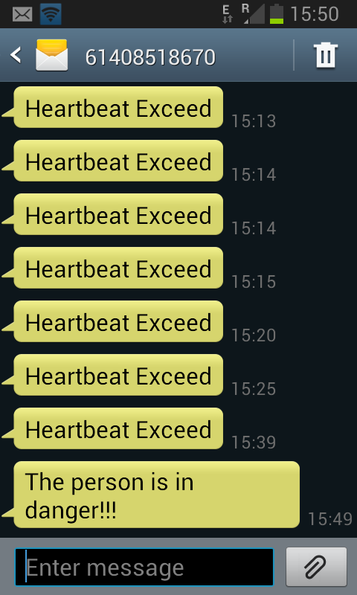
MOBILE PHONE SCREENSHOT

Slide 44
FUTURE SCOPE
EEG, ECG and other health parameters can also be monitored.
Continuous monitoring and future diagnosis can be performed via the same system (TELEMEDICINE).
More than a single patient at different places can be monitored using single system.

Slide 45
CONCLUSION
In the above mentioned system we have proposed a health monitoring system which is Cloud based.
User friendly and bridges gap between doctor and patients.
The system is simple, Power efficient.
Practical application of the system is superfine in rural areas as there would be no need for the patients to get their continuous follow-ups.

Slide 46
REFERENCES
International Journal of Science, Engineering and Technology Research (IJSETR), Volume 5, Issue 1, January 2016
Computer and Automation Engineering, 2009. ICCAE '09. International Conference on
Reviewed by Charles Patrick Davis, MD, PhD on Saturday, August 6,2016
Dipali Bansal Electron. & Commun. Eng. Dept., ApeejayColl. of Eng., Sohna” A Review of Measurement and Analysis of Heart Rate Variability” Computer and Automation Engineering, 2009. ICCAE '09. International Conference on 15 November 2010 Bangkok, Thailand
Department of Electronics and Communication Engineering, Gujarat Technological University, Ahmedabad, India
An Empirical Characterization of IFTTT: Ecosystem, Usage, and Performance
Patient Health Monitoring System using IOT devices

Slide 47
Continue…
Abu Nairn Rakib Ahmed Department of photonics, Vrije Universiteit Brüssel, Belgium,Kurt Barbé Department of mathematics, Vrije Universiteit Brüssel, Belgium “Photonic sensor design evaluation for measuring the photoplethysmogram” Instrumentation and Measurement Technology Conference Proceedings (I2MTC), 2016 IEEE International 15 November 2010 Bangkok, Thailand
Engineering in Medicine and Biology Society (EMBC), 2014 36th Annual International Conference of the IEEE
D.B. McCombie, A.T. Reisner, H.H. Asada, "Adaptive blood pressure estimation from wearable
ThingSpeakAPI-Report mediatechnology.leiden.edu/images/uploads/docs/wt2014_thingspeak.pdf
Colossal Data Analysis and Networking (CDAN), Symposium on
Instrumentation and Measurement Technology Conference Proceedings (I2MTC), 2016 IEEE International

Slide 48
THANK YOU !!

